Slide 1

Asymmetric-Key
Cryptography
Copyright © The McGraw-Hill Companies, Inc. Permission required for reproduction or display.
10.<number>

Slide 2
Chapter 10
Objectives
To distinguish between two cryptosystems:
symmetric-key and asymmetric-key
To introduce trapdoor one-way functions and their
use in asymmetric-key cryptosystems
To discuss the RSA cryptosystem
To discuss the Rabin cryptosystem
10.<number>

Slide 3
10-1 INTRODUCTION
Symmetric and asymmetric-key cryptography will exist in parallel and continue to serve the community. We actually believe that they are complements of each other; the advantages of one can compensate for the disadvantages of the other.
Topics discussed in this section:
10.1.1 Keys
10.1.2 General Idea
10.1.3 Need for Both
10.1.4 Trapdoor One-Way Function
10.1.5 Knapsack Cryptosystem
10.<number>

Slide 4

10-1 INTRODUCTION
Symmetric and asymmetric-key cryptography will exist in parallel and continue to serve the community. We actually believe that they are complements of each other; the advantages of one can compensate for the disadvantages of the other.
Note
Symmetric-key cryptography is based on sharing secrecy;
asymmetric-key cryptography is based on personal secrecy.
10.<number>

Slide 5
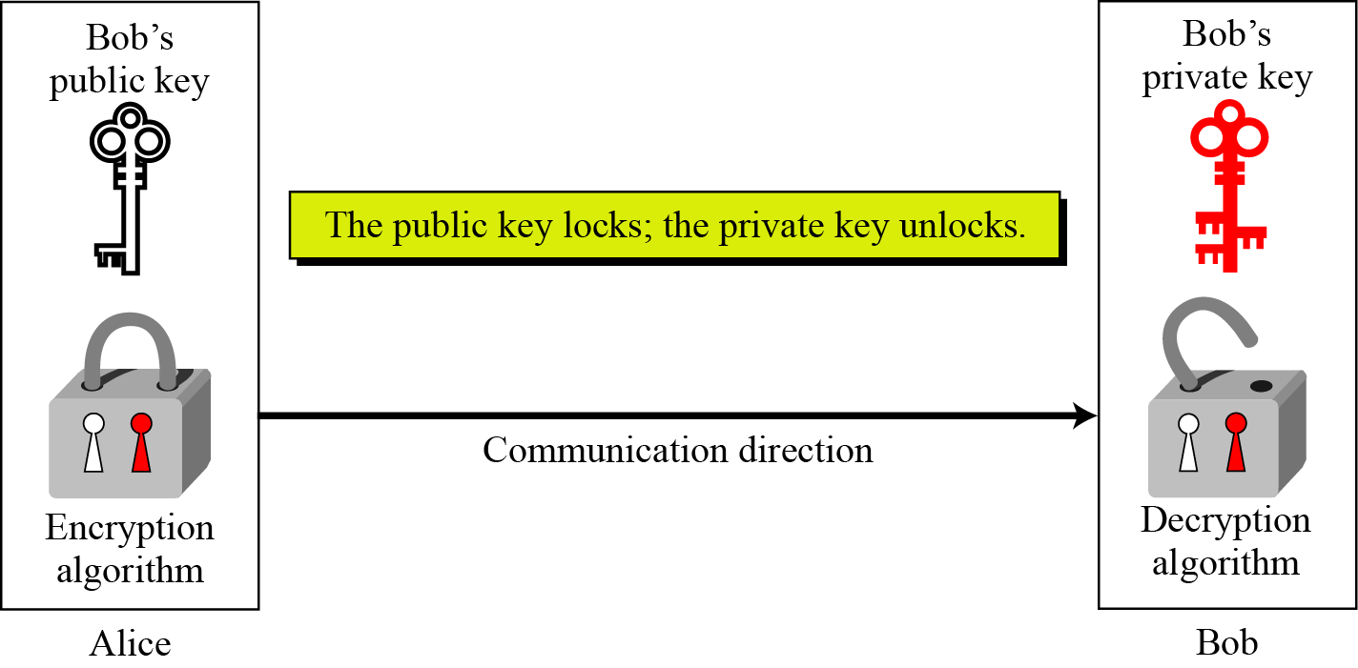
10.1.1 Keys
Asymmetric key cryptography uses two separate keys: one private and one public.
Figure 10.1 Locking and unlocking in asymmetric-key cryptosystem
10.<number>

Slide 6
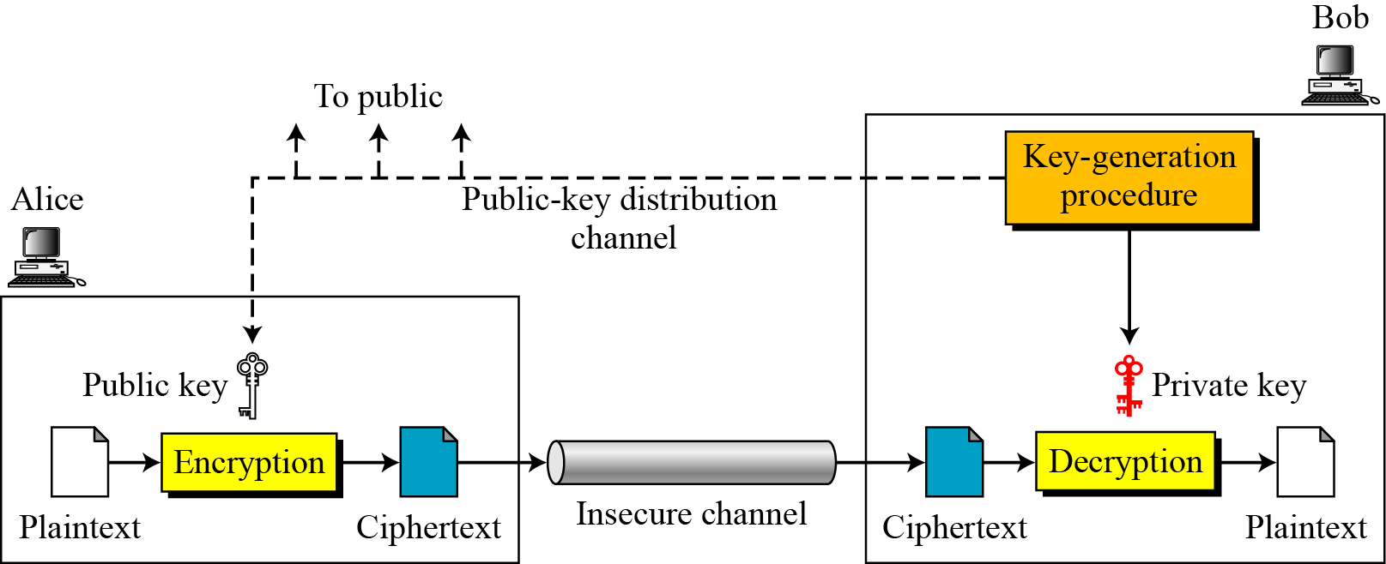
10.1.2 General Idea
Figure 10.2 General idea of asymmetric-key cryptosystem
10.<number>

Slide 7
10.1.2 Continued
Plaintext/Ciphertext
Unlike in symmetric-key cryptography, plaintext and ciphertext are treated as integers in asymmetric-key cryptography.
Encryption/Decryption
C = f (K_{public} , P) P = g(K_{private} , C)
10.<number>

Slide 8
10.1.3 Need for Both
There is a very important fact that is sometimes misunderstood: The advent of asymmetric-key cryptography does not eliminate the need for symmetric-key cryptography.
10.<number>

Slide 9
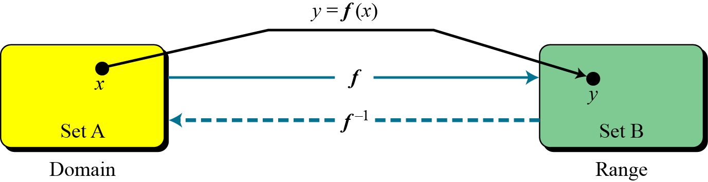
10.1.4 Trapdoor One-Way Function
The main idea behind asymmetric-key cryptography is the concept of the trapdoor one-way function.
Functions
Figure 10.3 A function as rule mapping a domain to a range
10.<number>

Slide 10
10.1.4 Continued
One-Way Function (OWF)
1. f is easy to compute.
2. f ⁻¹ is difficult to compute.
Trapdoor One-Way Function (TOWF)
3. Given y and a trapdoor, x can be
computed easily.
10.<number>

Slide 11
10.1.4 Continued
Example 10. 1
When n is large, n = p × q is a one-way function. Given p and q , it is always easy to calculate n ; given n, it is very difficult to compute p and q. This is the factorization problem.
Example 10. 2
When n is large, the function y = x^{k} mod n is a trapdoor one-way function. Given x, k, and n, it is easy to calculate y. Given y, k, and n, it is very difficult to calculate x. This is the discrete logarithm problem. However, if we know the trapdoor, k′ such that k × k ′ = 1 mod φ(n), we can use x = y^{k′} mod n to find x.
10.<number>

Slide 12
10-2 RSA CRYPTOSYSTEM
The most common public-key algorithm is the RSA cryptosystem, named for its inventors (Rivest, Shamir, and Adleman).
Topics discussed in this section:
10.2.1 Introduction
10.2.2 Procedure
10.2.3 Some Trivial Examples
10.2.4 Attacks on RSA
10.2.5 Recommendations
10.2.6 Optimal Asymmetric Encryption Padding (OAEP)
10.2.7 Applications
10.<number>

Slide 13
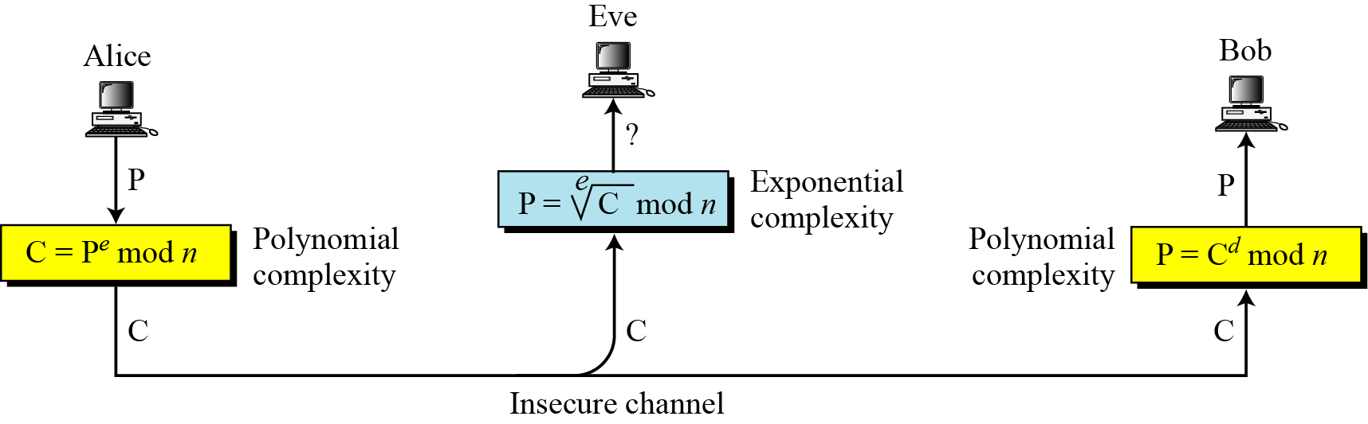
10.2.1 Introduction
Figure 10.5 Complexity of operations in RSA
10.<number>

Slide 14
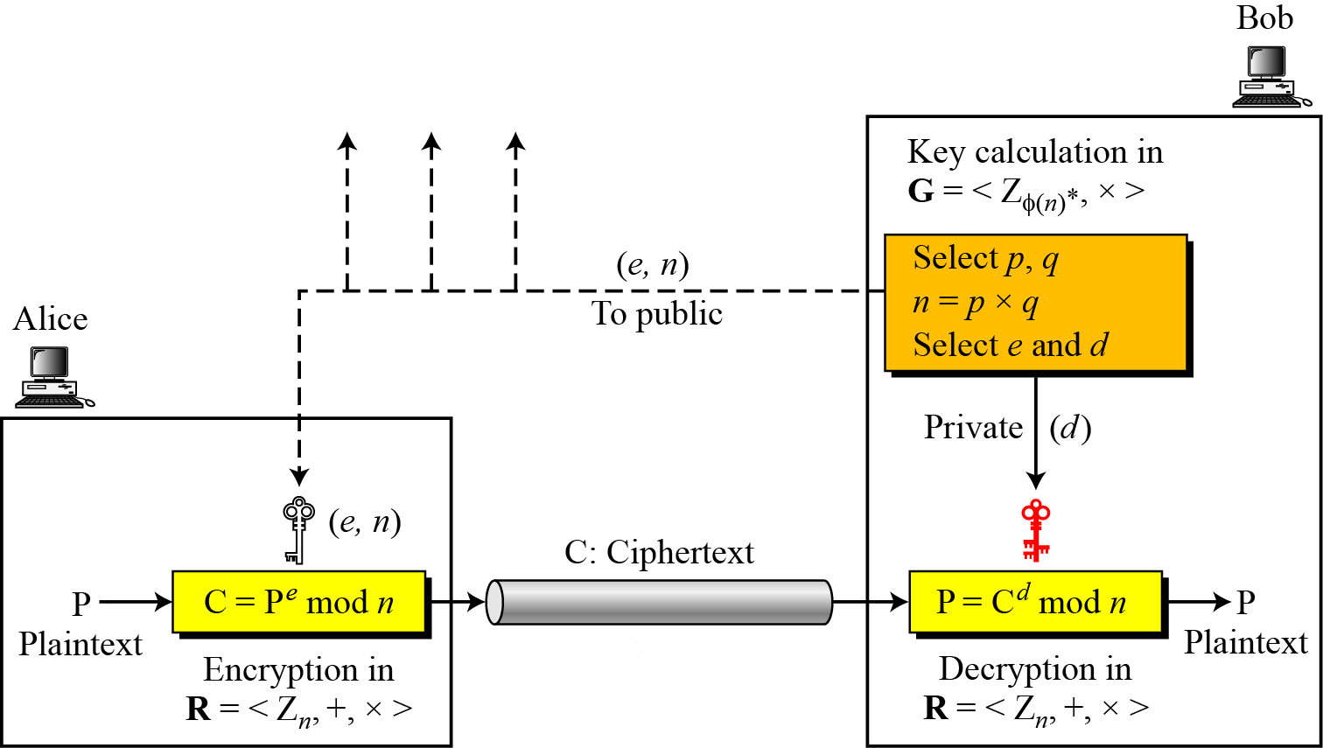
10.2.2 Procedure
Figure 10.6 Encryption, decryption, and key generation in RSA
10.<number>

Slide 15
10.2.2 Continued
Two Algebraic Structures
R = <Z_{n} , +, × >
Encryption/Decryption Ring:
Key-Generation Group:
G = <Z _{φ(n)}∗, × >
10.<number>

Slide 16
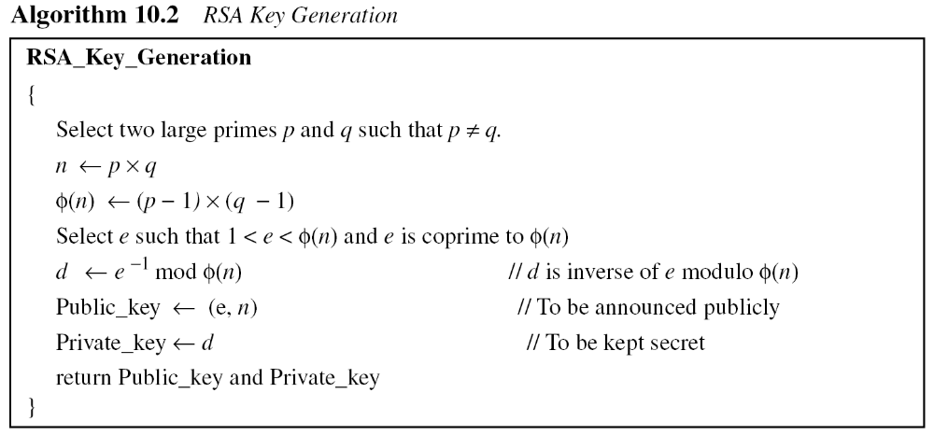
10.2.2 Continued
10.<number>

Slide 17
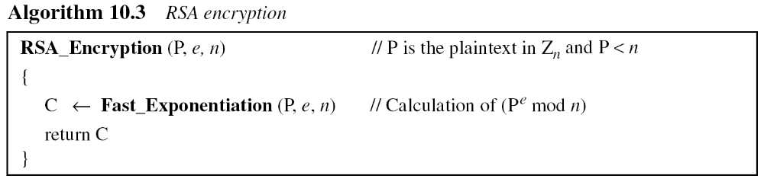
10.2.2 Continued
Encryption
10.<number>

Slide 18
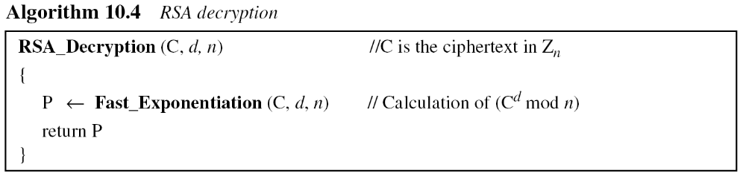
10.2.2 Continued
Decryption
10.<number>

Slide 19
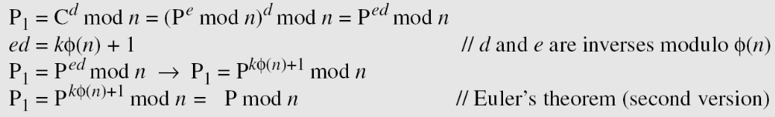
10.2.2 Continued
Proof of RSA
10.<number>

Slide 20
10.2.3 Some Trivial Examples
Example 10. 5
Bob chooses 7 and 11 as p and q and calculates n = 77. The value of φ(n) = (7 − 1)(11 − 1) or 60. Now he chooses two exponents, e and d, from Z₆₀∗. If he chooses e to be 13, then d is 37. Note that e × d mod 60 = 1 (they are inverses of each Now imagine that Alice wants to send the plaintext 5 to Bob. She uses the public exponent 13 to encrypt 5.
Bob receives the ciphertext 26 and uses the private key 37 to decipher the ciphertext:
10.<number>

Slide 21
10.2.3 Some Trivial Examples
Example 10. 6
Now assume that another person, John, wants to send a message to Bob. John can use the same public key announced by Bob (probably on his website), 13; John’s plaintext is 63. John calculates the following:
Bob receives the ciphertext 28 and uses his private key 37 to decipher the ciphertext:
10.<number>

Slide 22
10.2.3 Some Trivial Examples
Example 10. 7
Jennifer creates a pair of keys for herself. She chooses p = 397 and q = 401. She calculates
n = 159197. She then calculates φ(n) = 158400. She then chooses e = 343 and d = 12007. Show how Ted can send a message to Jennifer if he knows e and n.
Suppose Ted wants to send the message “NO” to Jennifer. He changes each character to a number (from 00 to 25), with each character coded as two digits. He then concatenates the two coded characters and gets a four-digit number. The plaintext is 1314. Figure 10.7 shows the process.
10.<number>

Slide 23
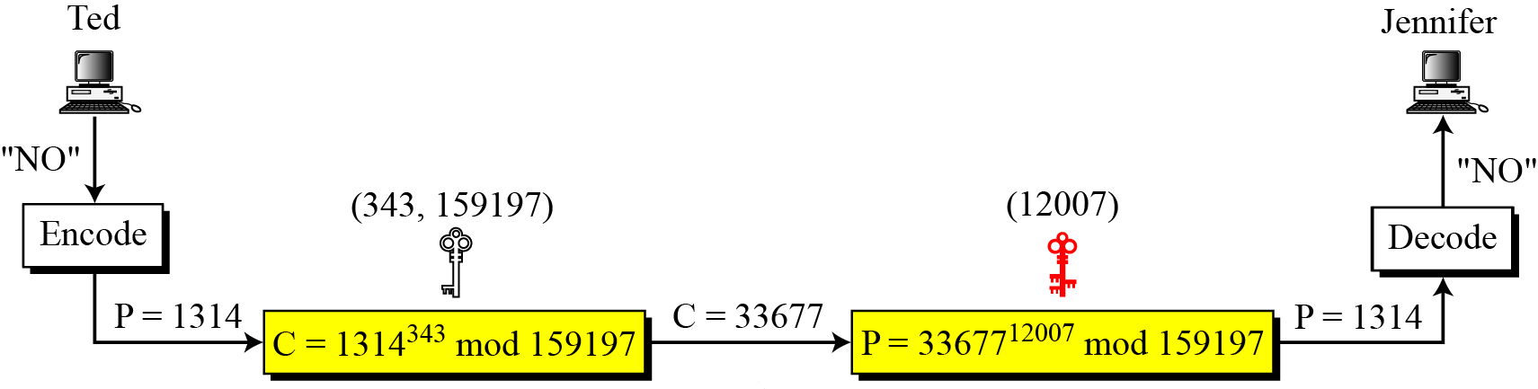
10.2.3 Continued
Figure 10.7 Encryption and decryption in Example 10.7
10.<number>

Slide 24
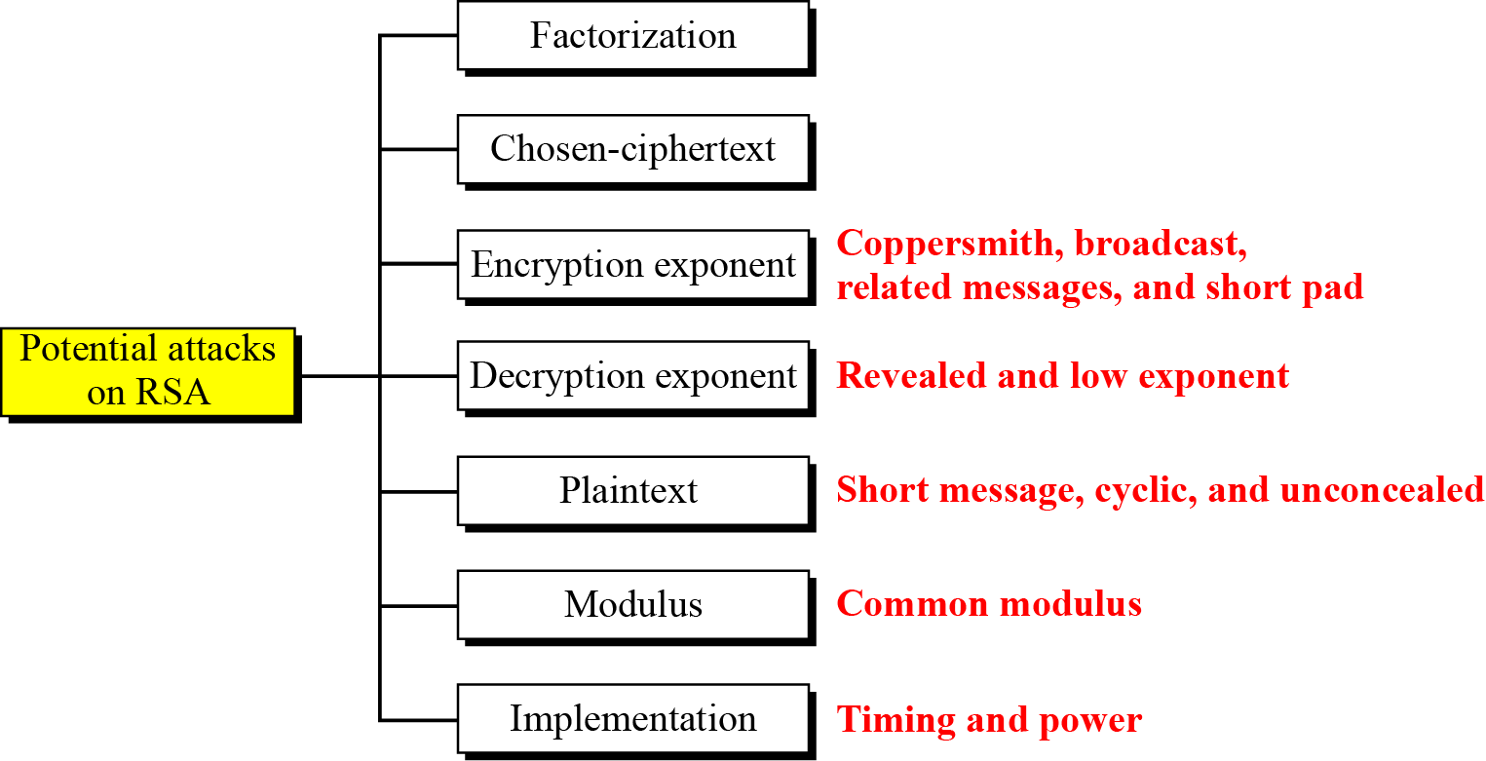
10.2.4 Attacks on RSA
Figure 10.8 Taxonomy of potential attacks on RSA
No devastating attacks on RSA have been yet discovered.
10.<number>

Slide 25
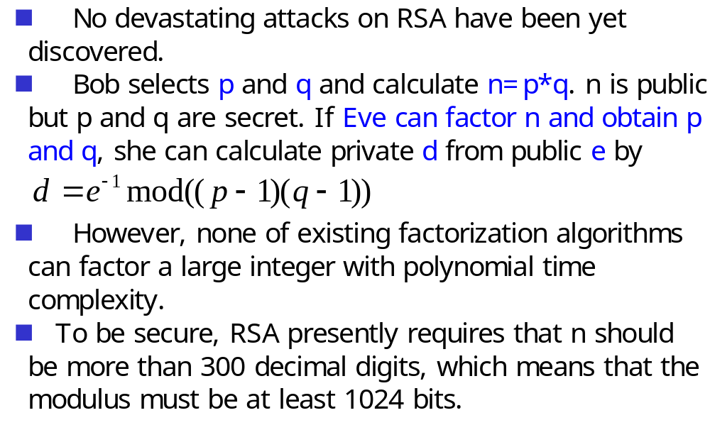
10.2.4 Attacks on RSA – Factorization Attack
10.<number>

Slide 26
10.2.4 Attacks on RSA – Chosen ciphertext attack
Chosen-ciphertext attack
  Assume Alice creates the ciphertext and sends C to Bob. Also assume that Bob will decrypt an arbitrary ciphertext for Eve, other than C.
  Eve intercepts C and uses the following steps:
    Eve chooses a random integer X
    Eve calculates Y = C * X^e mod n
    Eve sends Y to Bob for decryption and get Z=Y^d mod n; this step is an instance of a chosen ciphertext attack.
    Eve can easily find C because
    Z = Y^d mod n = (C * X^e)^d mod n = (C^d * X^ed) mod n = (C^d * X) mod n = (P*X)mod n
    Z = (P*X)mod n → P = Z*X^(-1) mod n
10.<number>

Slide 27
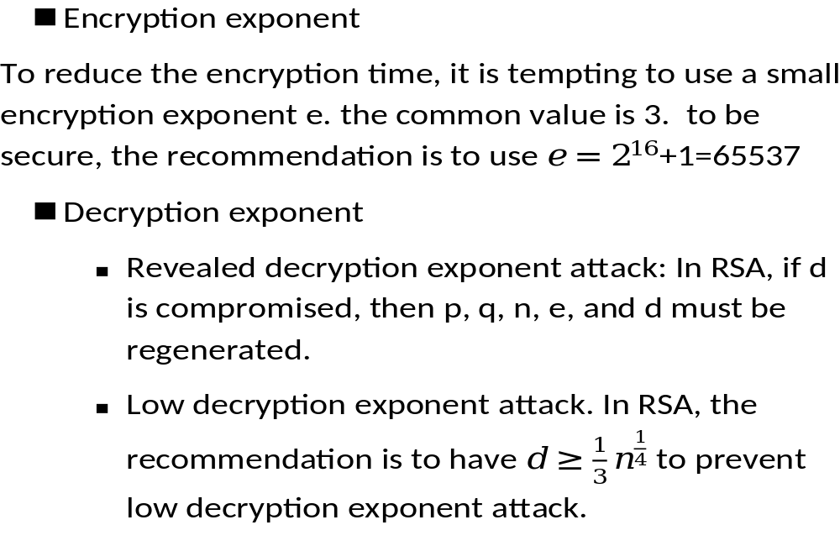
Attacks on RSA – attacks on encryption exponent
10.<number>

Slide 28
10.2.4 Attacks on RSA – Plaintext attack
Plaintext attack
  Short message attack – if it is known that Alice is sending a four-digit number to Bob, Eve can easily try plaintext numbers from 0000 to 9999 to find the plaintext. Therefore, short msg must be padded with random bits.
  Cycling attack – the continuous encryption of the ciphertext will eventually result in the plaintext. The complexity of this is equivalent to the complexity of factoring n.
  Concealed Message – a message that encrypts to itself, e.g. P=0 and P=1
10.<number>

Slide 29
10.2.4 Attacks on RSA -- Attacks on implementation
Timing attack
  RSA fast-exponential algorithm uses
    only squaring if the corresponding bit in the private exponent d is 0. requires shorter time to decrypt.
    Both squaring and multiplication if the corresponding bit is 1. requires longer time to decrypt
  This timing difference allows Eve to find the value of bits in d, one by one.
Powering attack
  An iteration involving multiplication and squaring consumes more power than an iteration that uses only squaring.
10.<number>

Slide 30
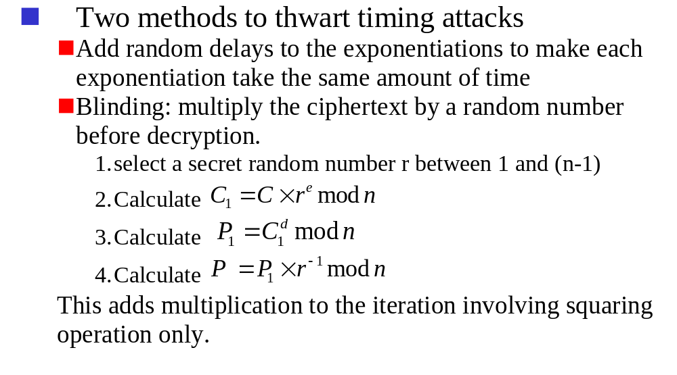
10.2.4 Attacks on RSA -- Attacks on implementation
10.<number>

Slide 31
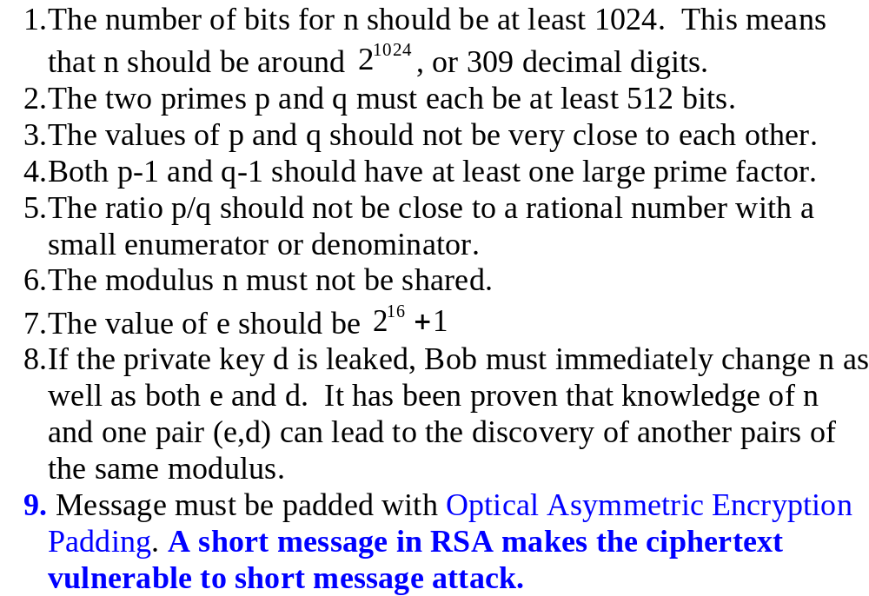
RSA Recommendations
10.<number>

Slide 32
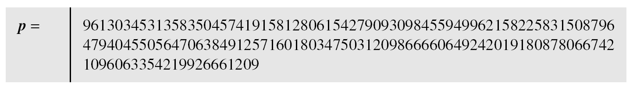
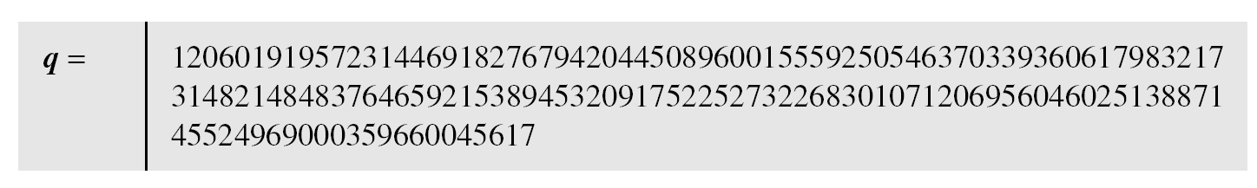
10.2.6 Continued
Example 10. 8
Here is a more realistic example. We choose a 512-bit p and q, calculate n and φ(n), then choose e and test for relative primeness with φ(n). We then calculate d. Finally, we show the results of encryption and decryption. The integer p is a 159-digit number.
10.<number>

Slide 33
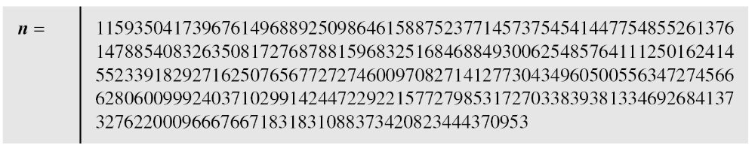
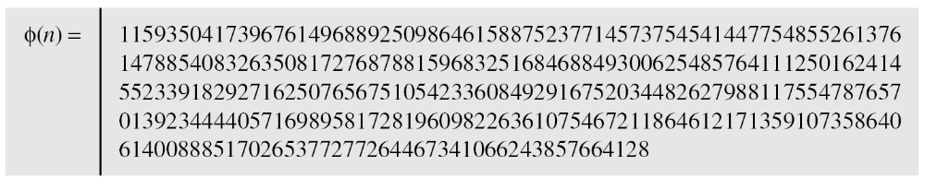
10.2.6 Continued
Example 10. 8
Continued
The modulus n = p × q. It has 309 digits.
φ(n) = (p − 1)(q − 1) has 309 digits.
10.<number>

Slide 34
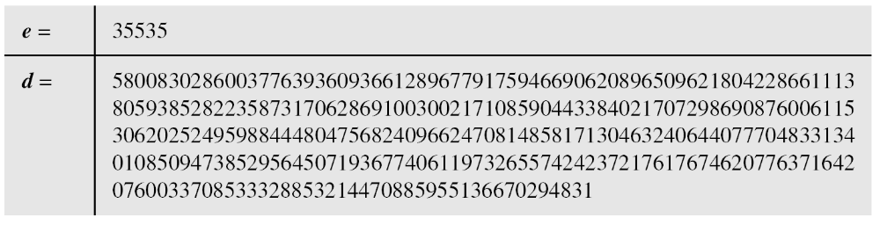
10.2.6 Continued
Example 10. 8
Continued
Bob chooses e = 35535 (the ideal is 65537) and tests it to make sure it is relatively prime with φ(n). He then finds the inverse of e modulo φ(n) and calls it d.
10.<number>

Slide 35
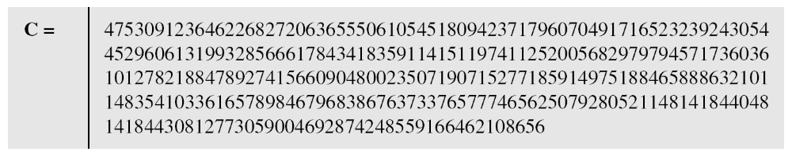
10.2.6 Continued
Example 10. 8
Continued
Alice wants to send the message “THIS IS A TEST”, which can be changed to a numeric value using the 00−26 encoding scheme (26 is the space character).
The ciphertext calculated by Alice is C = P^{e}, which is
10.<number>

Slide 36
10.2.6 Continued
Example 10. 8
Continued
Bob can recover the plaintext from the ciphertext using P = C^{d}, which is
The recovered plaintext is “THIS IS A TEST” after decoding.
10.<number>

Slide 37
10-3 RABIN CRYPTOSYSTEM
The Rabin cryptosystem can be thought of as an RSA cryptosystem in which the value of e and d are fixed. The encryption is C ≡ P² (mod n) and the decryption is P ≡ C^{1/2} (mod n).
Topics discussed in this section:
10.3.1 Procedure
10.3.2 Security of the Rabin System
10.<number>

Slide 38
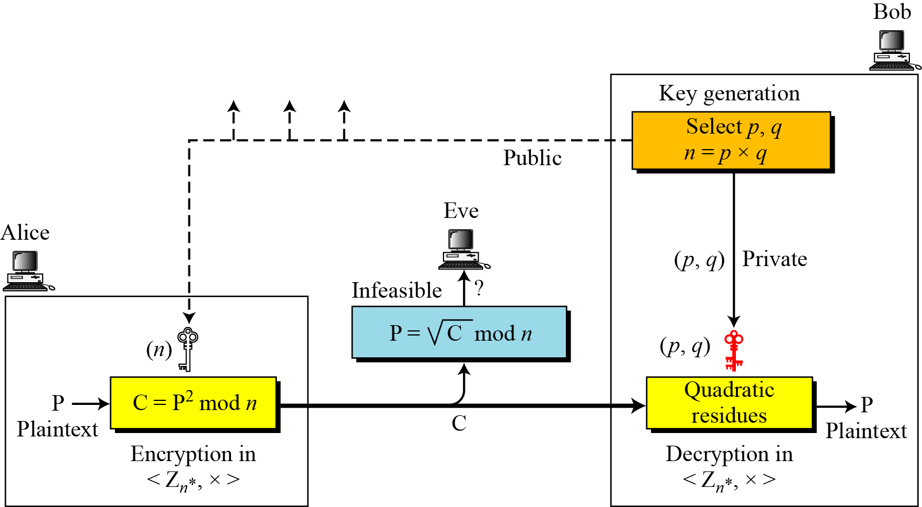
10-3 Continued
Figure 10.10 Rabin cryptosystem
10.<number>

Slide 39
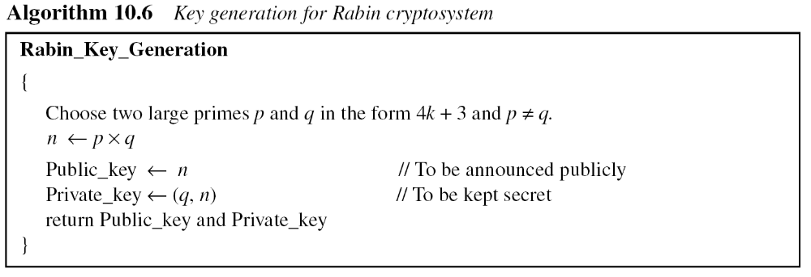
10.3.1 Procedure
Key Generation
10.<number>

Slide 40
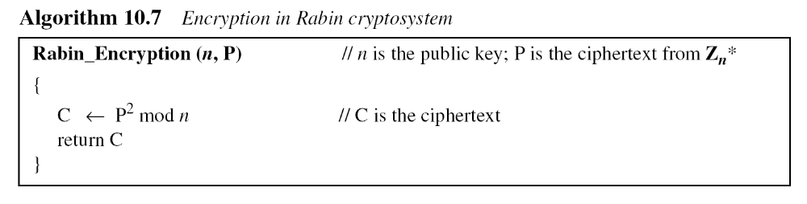
10.3.1 Continued
Encryption
10.<number>

Slide 41
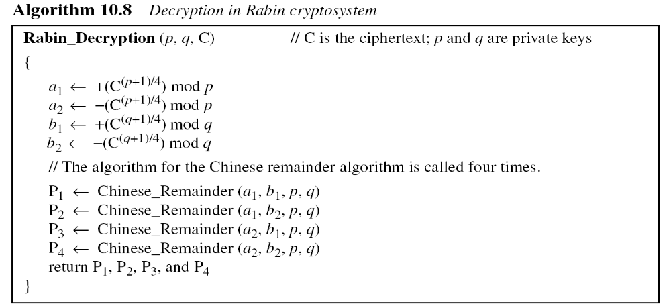
10.3.1 Continued
Decryption
Note
The Rabin cryptosystem is not deterministic: Decryption creates four plaintexts.
10.<number>

Slide 42
10.3.1 Continued
Example 10. 9
Here is a very trivial example to show the idea.
Bob selects p = 23 and q = 7. Note that both are
congruent to 3 mod 4.
Bob calculates n = p × q = 161.
Bob announces n publicly; he keeps p and q private.
Alice wants to send the plaintext P = 24. Note that 161 and 24 are relatively prime; 24 is in Z₁₆₁*. She calculates C = 24² = 93 mod 161, and sends the ciphertext 93 to Bob.
10.<number>

Slide 43
10.3.1 Continued
Example 10. 9
Bob receives 93 and calculates four values:
a₁ = +(93 ^{(23+1)/4}) mod 23 = 1 mod 23
a₂ = −(93 ^{(23+1)/4}) mod 23 = 22 mod 23
b₁ = +(93 ^{(7+1)/4}) mod 7 = 4 mod 7
b₂ = −(93 ^{(7+1)/4}) mod 7 = 3 mod 7
Bob takes four possible answers, (a₁, b₁), (a₁, b₂), (a₂, b₁), and (a₂, b₂), and uses the Chinese remainder theorem to find four possible plaintexts: 116, 24, 137, and 45. Note that only the second answer is Alice’s plaintext.
10.<number>

Slide 44
Security of Rabin System
  Secure as long as p and q are large numbers
  Complexity same as factoring a large number n into its prime factors p and q
  Rabin system is as secure as RSA
10.<number>

Slide 45
15-3 SYMMETRIC-KEY AGREEMENT
Alice and Bob can create a session key between themselves without using a KDC. This method of session-key creation is referred to as the symmetric-key agreement.
Topics discussed in this section:
15.3.1 Diffie-Hellman Key Agreement
15.<number>

Slide 46
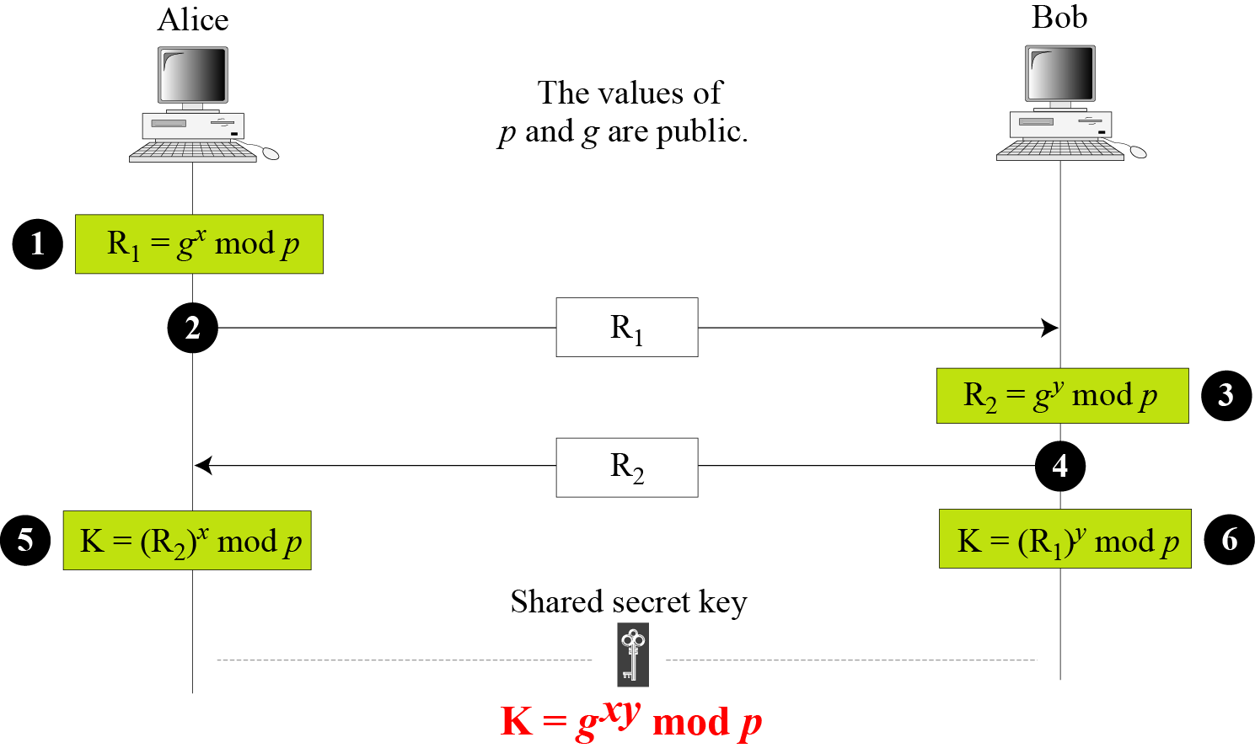
15.3.1 Diffie-Hellman Key Agreement
Figure 15.9 Diffie-Hellman method
15.<number>

Slide 47
15.3.1 Continued
Note
The symmetric (shared) key in the Diffie-Hellman method is K = g^{xy} mod p.
15.<number>

Slide 48
15.3.1 Continued
Example 15.1
Let us give a trivial example to make the procedure clear. Our example uses small numbers, but note that in a real situation, the numbers are very large. Assume that g = 7 and p = 23. The steps are as follows:
Alice chooses x = 3 and calculates R₁ = 73 mod 23 = 21.
Bob chooses y = 6 and calculates R₂ = 76 mod 23 = 4.
Alice sends the number 21 to Bob.
Bob sends the number 4 to Alice.
Alice calculates the symmetric key K = 43 mod 23 = 18.
Bob calculates the symmetric key K = 216 mod 23 = 18.
The value of K is the same for both Alice and Bob;
g^{xy} mod p = 718 mod 35 = 18.
15.<number>

Slide 49
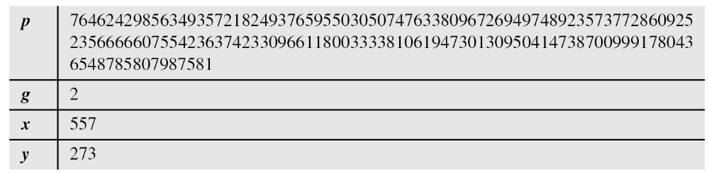
15.3.1 Continued
Example 15.2
Let us give a more realistic example. We used a program to create a random integer of 512 bits (the ideal is 1024 bits). The integer p is a 159-digit number. We also choose g, x, and y as shown below:
15.<number>

Slide 50
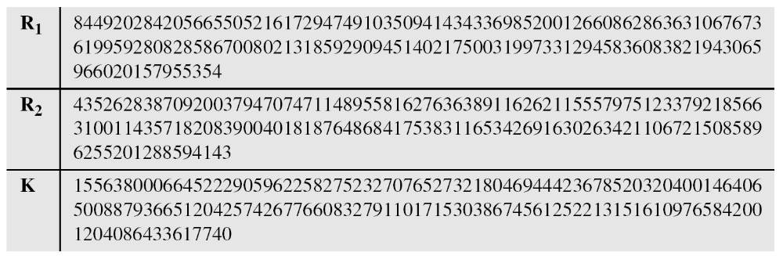
15.3.1 Continued
Example 15.2
Continued
The following shows the values of R₁, R₂, and K.
15.<number>

Slide 51
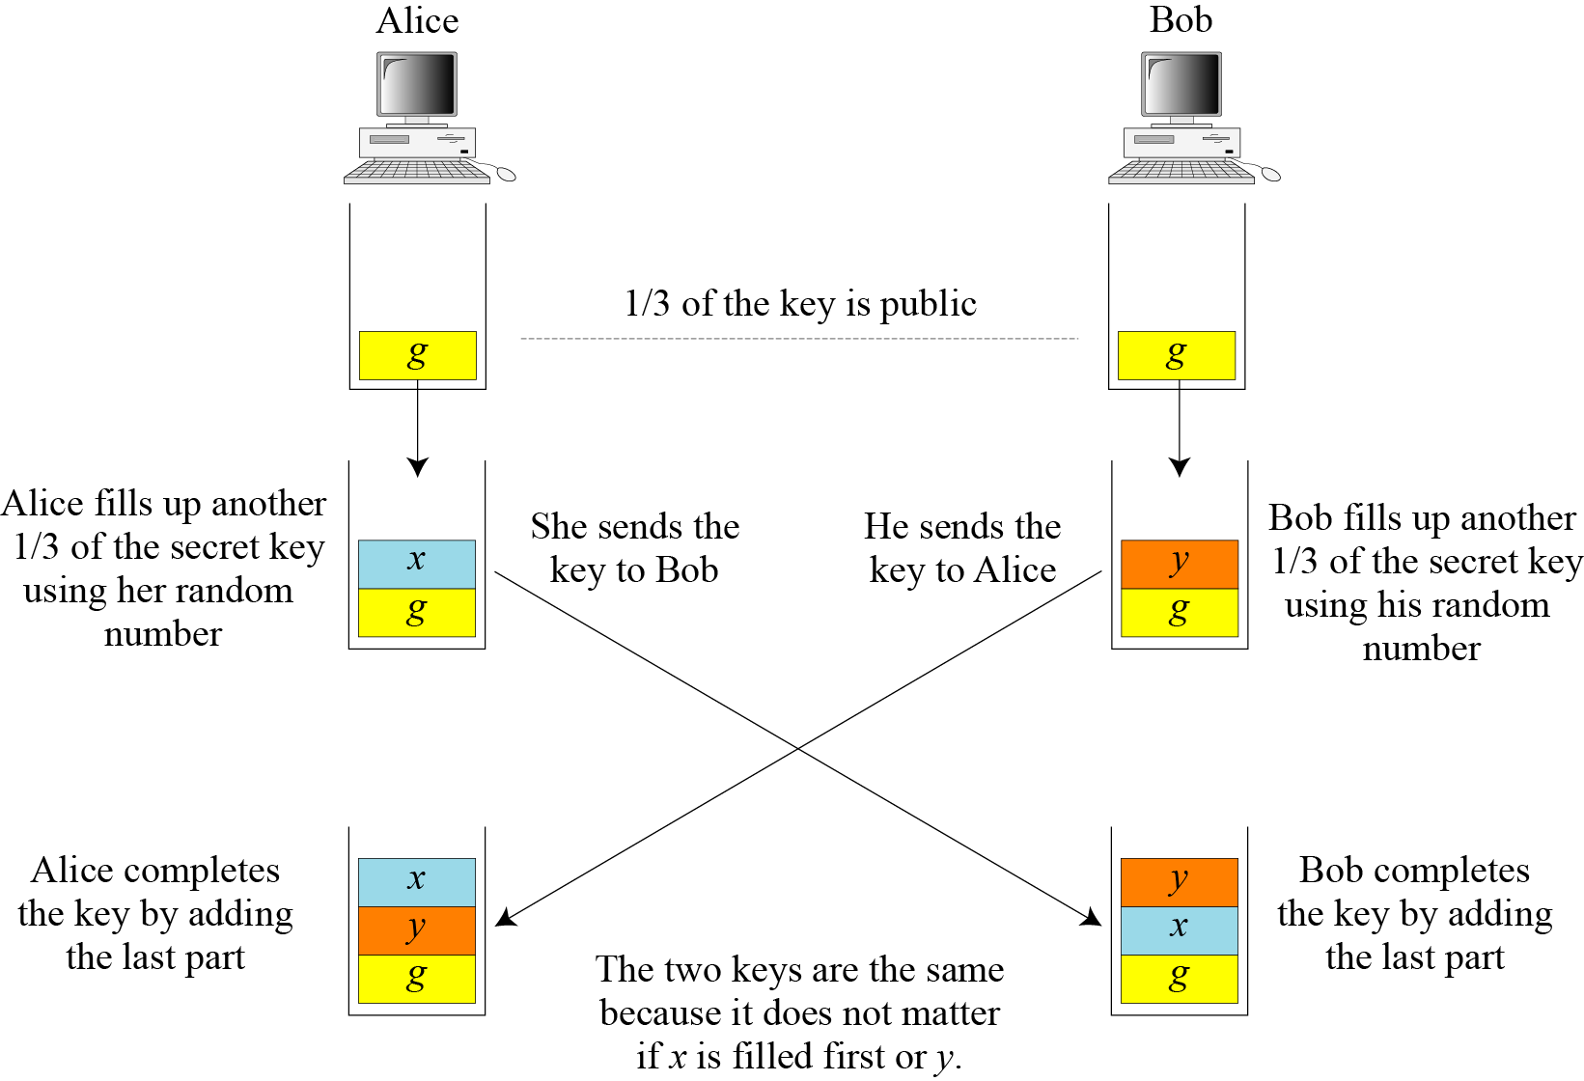
15.3.1 Continued
Figure 15.10 Diffie-Hellman idea
15.<number>

Slide 52
15.3.1 Continued
Security of Diffie-Hellman
Discrete Logarithm Attack
Man-in-the-Middle Attack
15.<number>

Slide 53
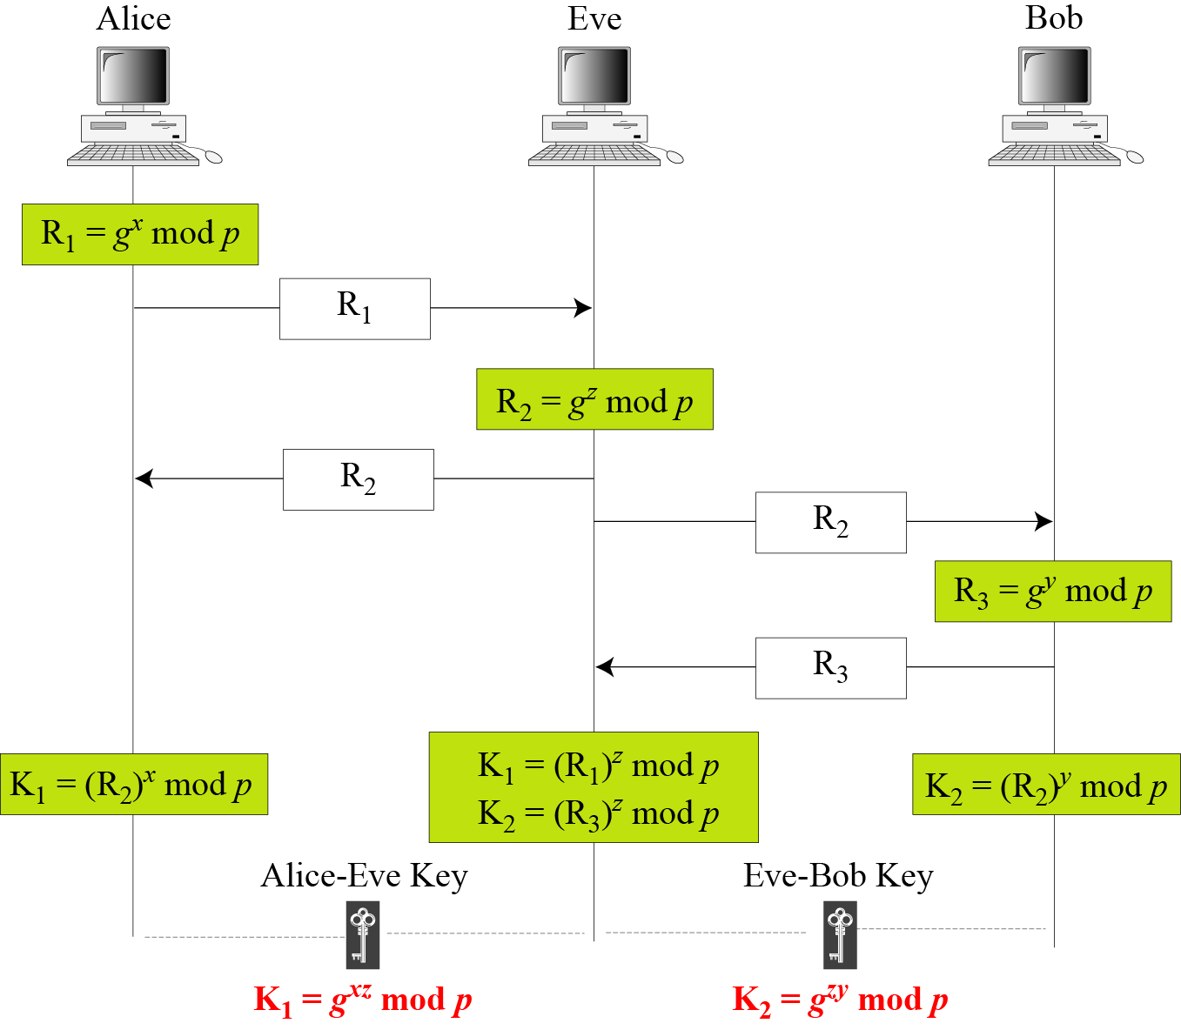
15.3.1 Continued
Figure 15.11 Man-in-the-middle attack
15.<number>

Slide 54
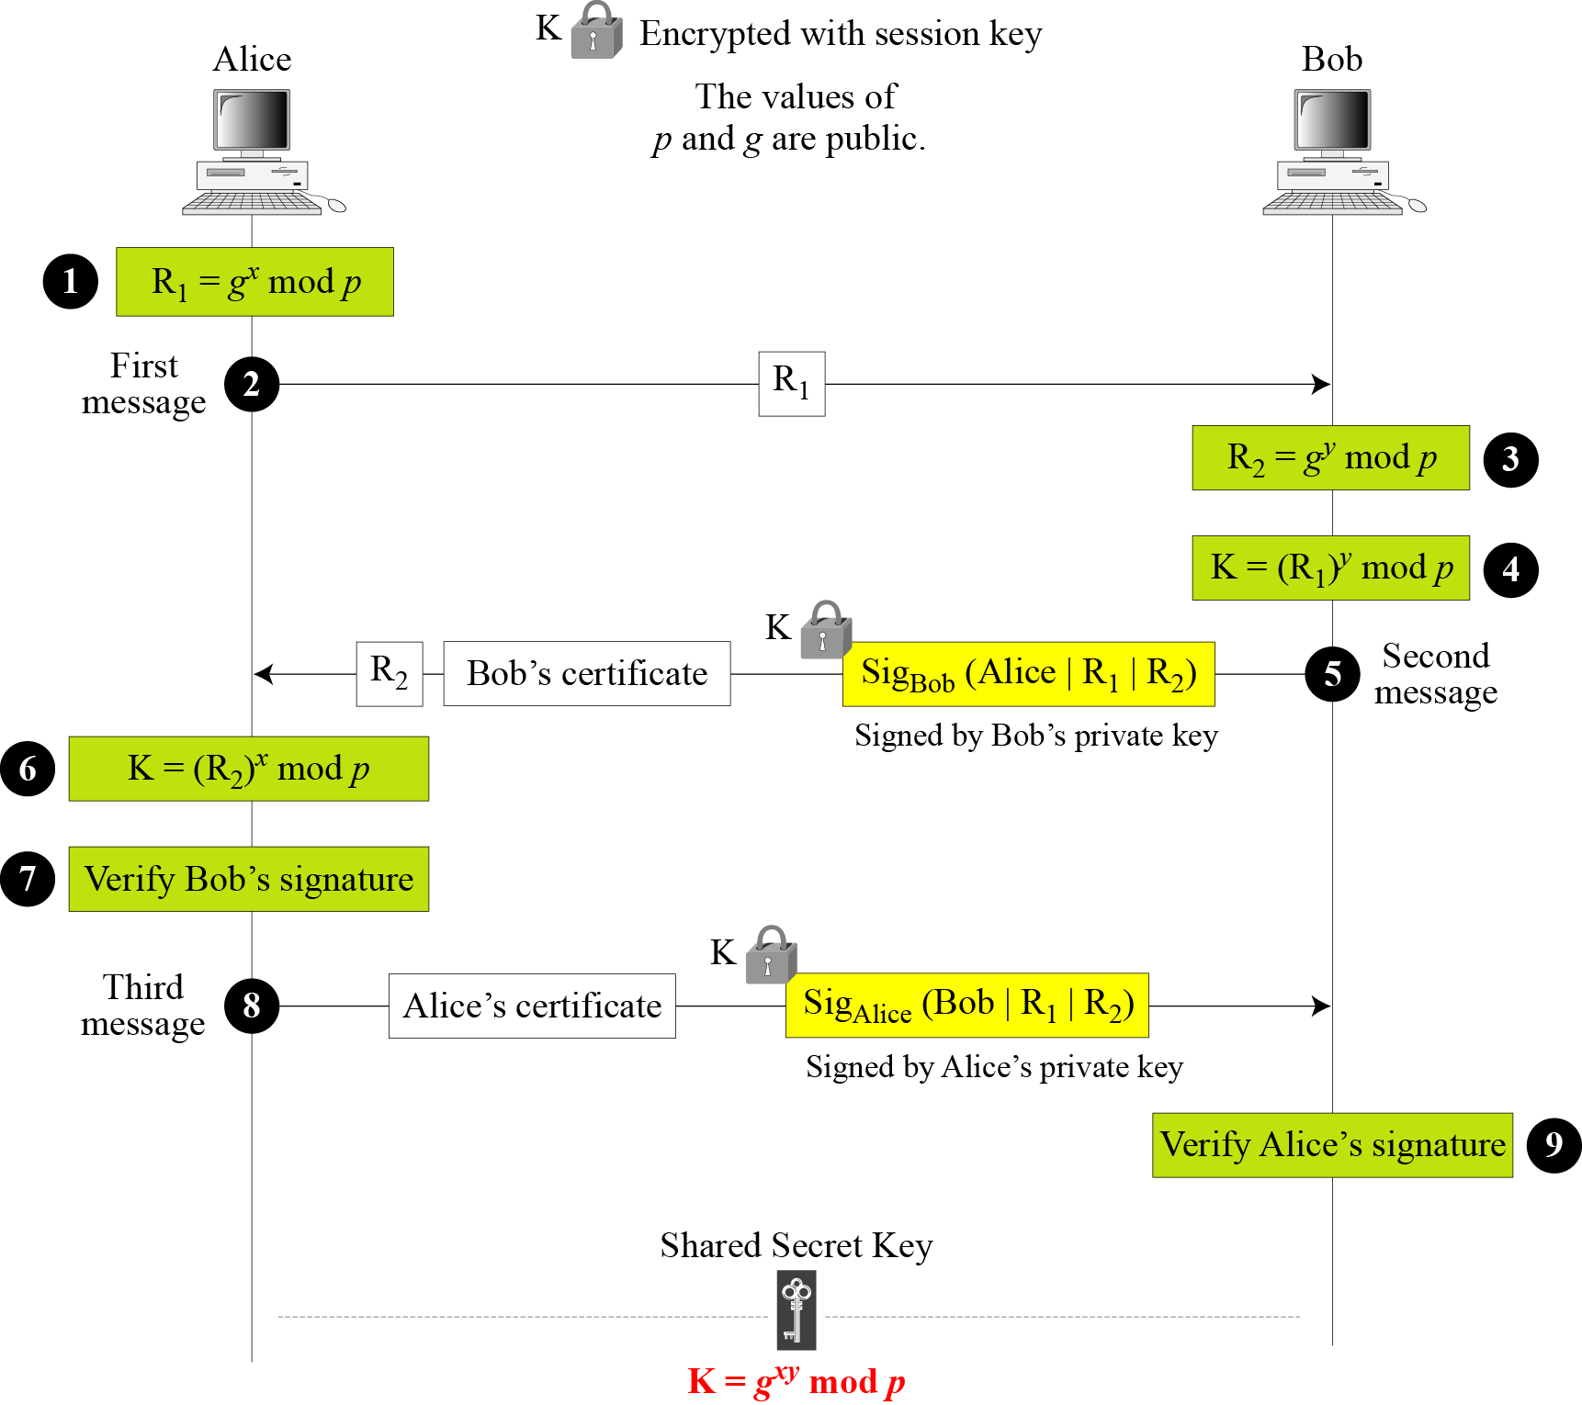
15.3.2 Station-to-Station Key Agreement
Figure 15.12 Station-to-station key agreement method
15.<number>

